Slide 1

DevOps in the Cloud Computing World
By: Hammad Aslam,
Sr. Site Reliability Engineer/DevOps Consultant

Slide 2
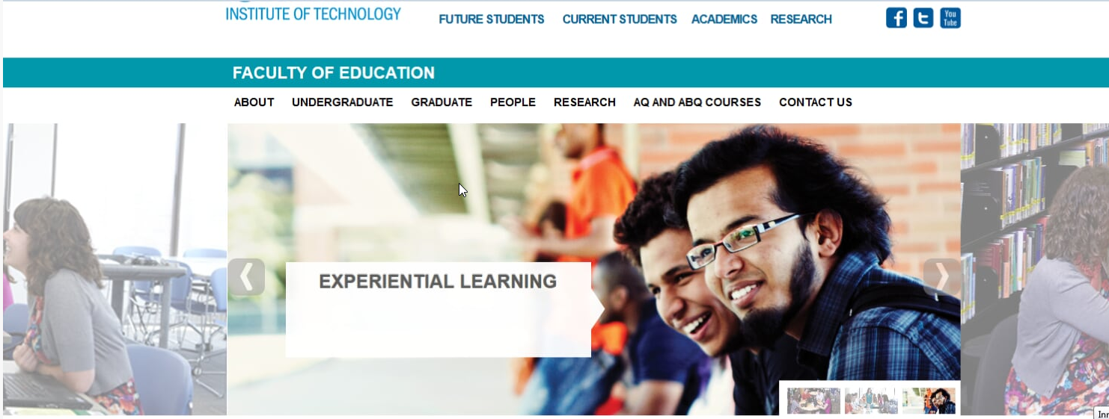
About Me
Software Engineering Class of 2014.
Worked at ACE from 2012-2014.
Technical Analyst at IBM until 2017.
Currently Sr. Site Reliability Engineer / DevOps Consultant at ICF.

Slide 3
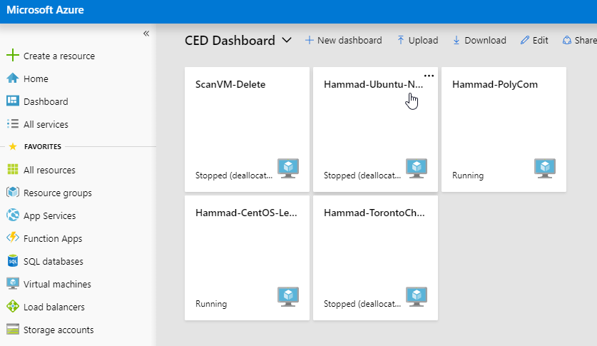
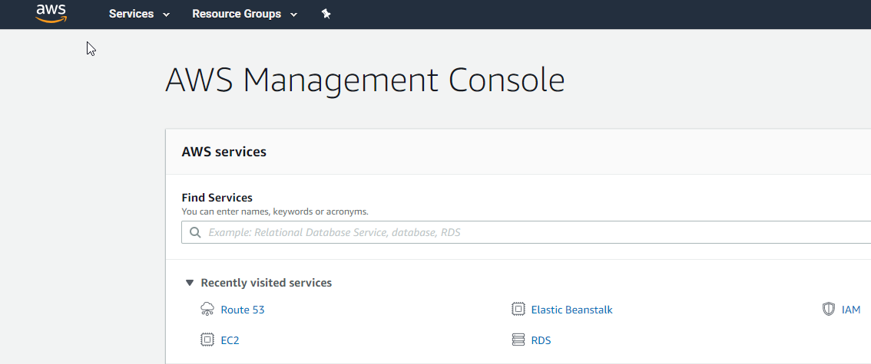
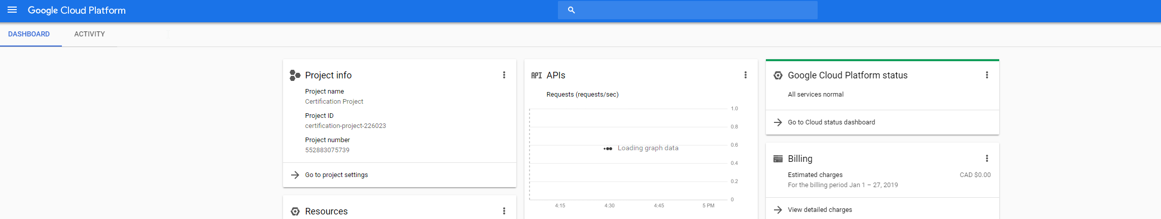
My Exposure to Cloud Computing
4th Year Cloud Computing course in 2014. Was mostly focused around Ruby as rails applications.
Starting in IBM, started interacting with customers that had environments in the Cloud. Since our application was heavily dependent on Microsoft SQL. Azure was the most platform I came across.
Now as a Sr.SRE, I build, maintain, and migrate environments to the Cloud. Cloud Platforms such as AWS, Azure, GCP and even AliBaba.

Slide 4
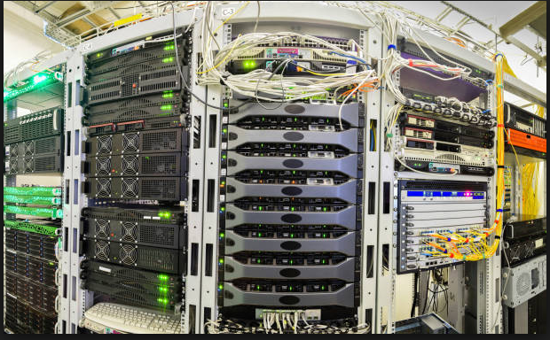
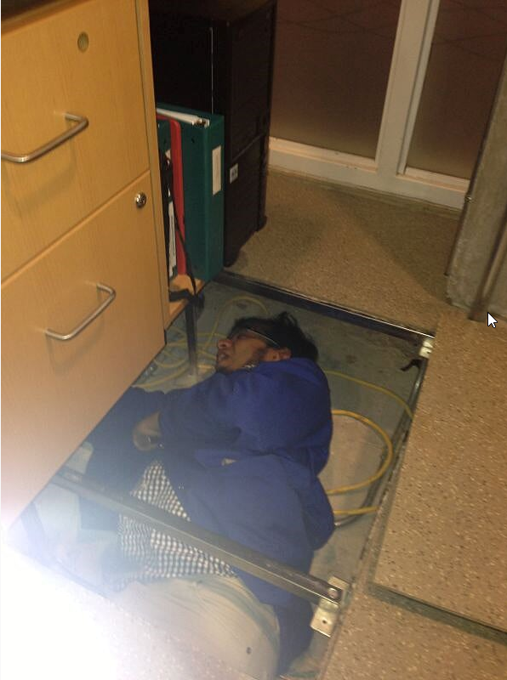


How did Cloud Computing change everything?
Every application, website and online services is hosted somewhere on a physical infrastructure.
Building a simple reliable application that has 2 front-end components along with a back-end component (database) would take about 6 - 10 weeks to set-up from an infrastructure perspective.
Notes:
Things like: Buying and ordering required hardware components such as servers, routers and switches. Are you putting this in a room in your office or do you want to get a lease with a data center. Buying licenses and setting all this up.
Investing hoping to generate revenue later
.

Slide 5
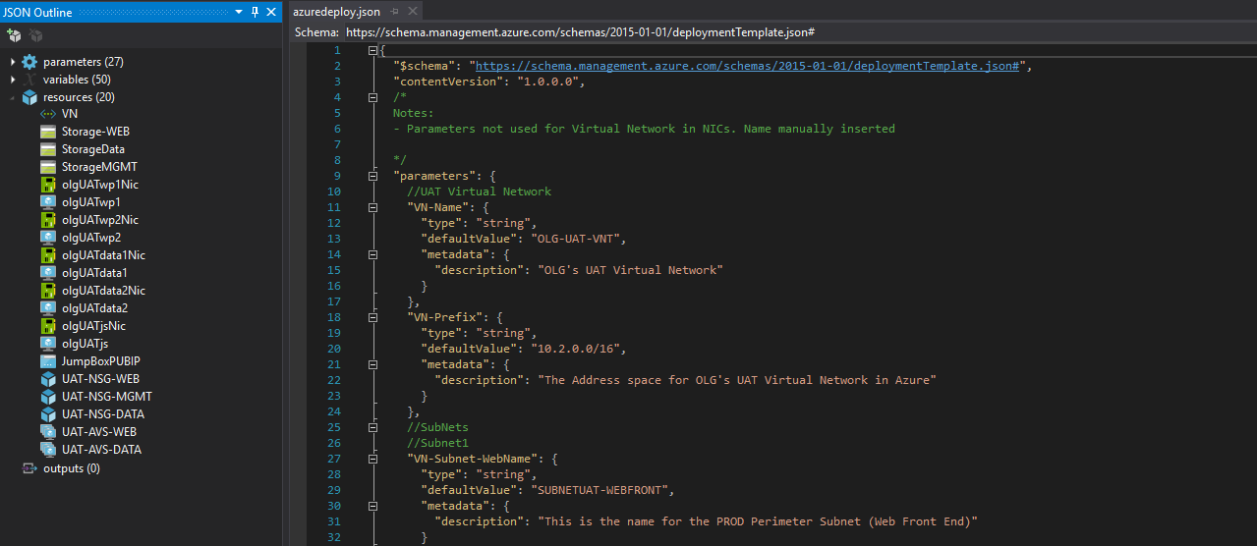
How did Cloud Computing change everything(Cont’d)
So now in the Cloud, what usually happens?
A developer can go and quickly spin up a test instance with a small DB for testing purposes. No need to contact operations to set up infrastructure and licenses.
A developer can deploy their application directly using services such as Elastic BeanStalk on AWS or Web Apps on Azure.
And my personal favorite: For a more robust larger environment, use IaC (Infrastructure as a Code)

Slide 6
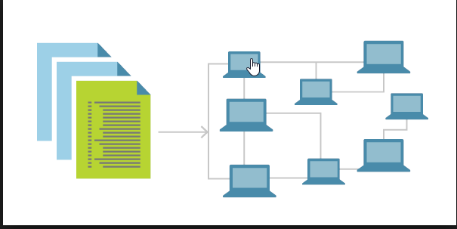
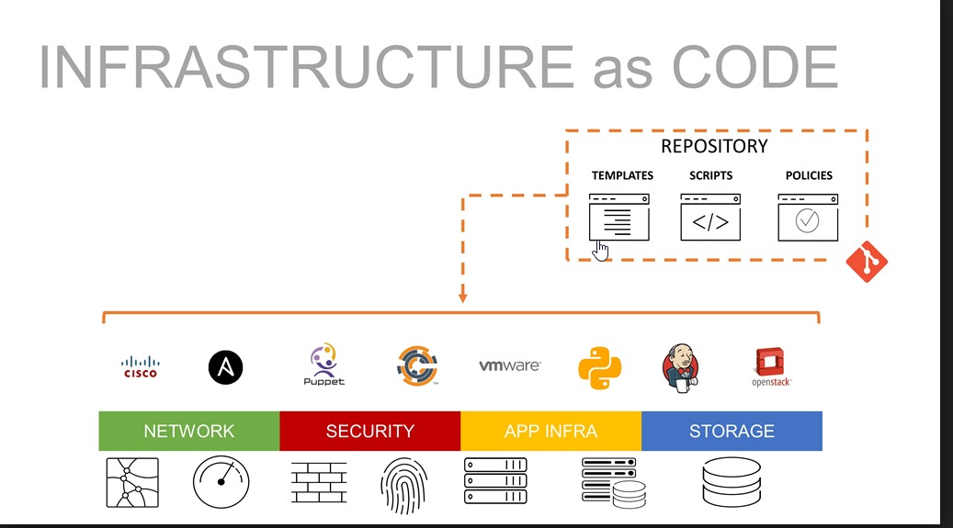
Infrastructure as Code (IaC)
IaC has now become the standard to build and maintain environments. Its basically applying Software Engineering tools and practices to infrastructure.
When you are working on a huge environment with 30 VMs, multiple databases and multiple tiers (UAT, Dev and Production). It becomes very hard to keep them all consistent.
For Azure, we use ARM (JSON) and for AWS, you can CloudFormation.
This way, you don’t go and set up each individual network, VM or machine. You write code that takes care of all that for you.
Any questions on IaC?
Notes:
Demo

Slide 7
Demo
Deploy ARM template to Azure.
Template contains 4 VMs in a Virtual Network. 2 in the front end subnet and 2 in the backend.

Slide 8
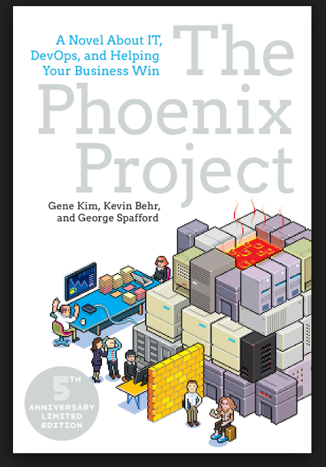
DevOps
What is DevOps? And why was there a need for DevOps?
How did Cloud help the DevOps mentality?
Examples of DevOps methodologies
The Phoenix Project, a great novel that helps you understand how DevOps can transform a business.
Notes:
What is DevOps?
It’s a merging of development and operations.
In a traditional organization that does not implement DevOps. Developers and Operations will always be arguing and pointing fingers at each other.
- A new release comes out and performance gets affected, suddenly at peak after hour, site goes down.. Operations will blame a new code. Developer will be like, it was fine on my laptop, something wrong with your infrastructure. Lets say a bug is identified the developer will work on a fix and have it ready. Now what will he do with fix? Well, he will need to compile it and package and somehow send it over to the Ops people. But wait a second, it was never tested properly. Ops person does not know how to do the deployment or what manual configuration are needed. All this time site is down and company loses revenue.
So what we see here, is the developers are only taking responsibility for their code and Ops people only for their machines. This is where DevOps comes in.
How did Cloud Help?
Quickly build and destrpy environments.
No upfront cost
Upscale
Examples:
Lets assume the deployment took place, and site is down. We will have tools like Jenkins that we can quickly roll-back. Previous version is deployed.

Slide 9
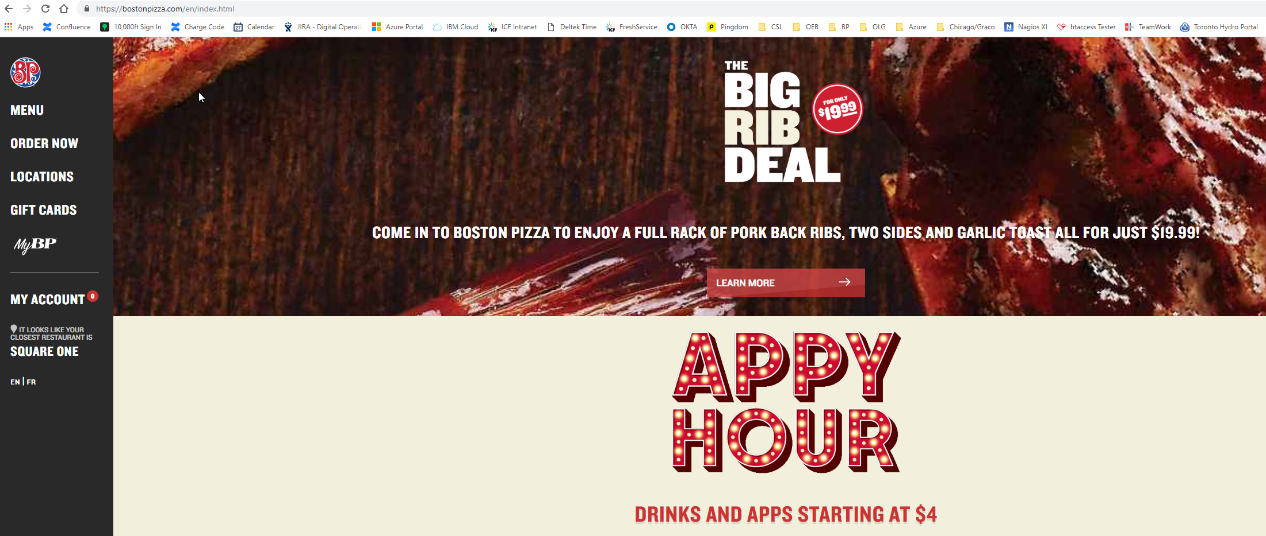
Real Life Examples
Boston Pizza
REDACTED FOR INTERNET

Slide 10
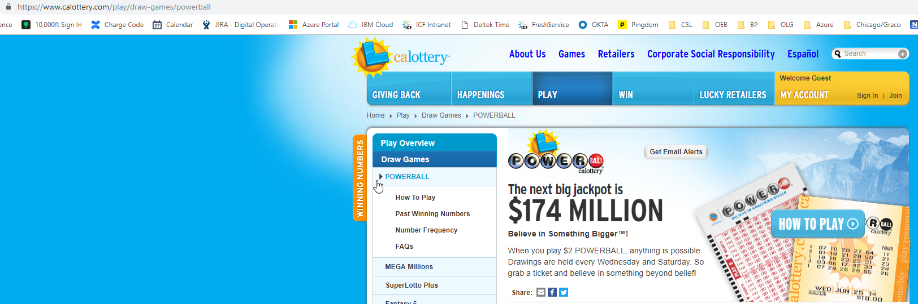
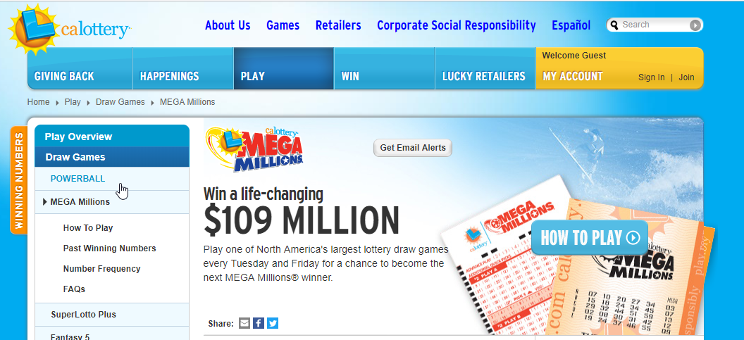
Real Life Examples
California Lottery
REDACTED FOR INTERNET

Slide 11
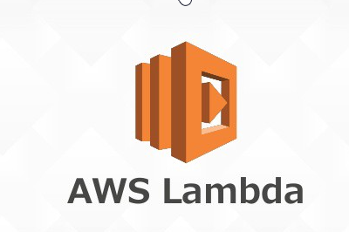
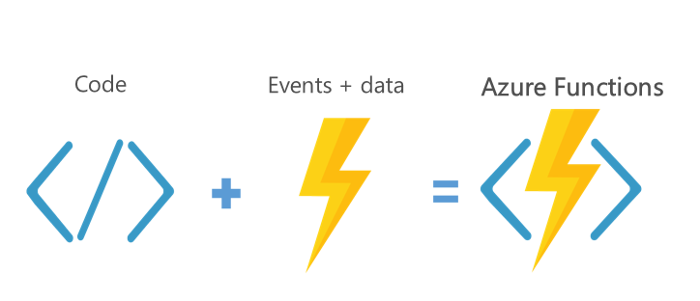
What is new in the CC World?
Moving from traditional Virtual machines to more PaaS (platform as a service) solutions.
PaaS tools such as RDS, Azure DB and Web apps.
Containers such as Docker and Kuberentes.
The craziest of all: Lambda and Functions.
If no users are using, no cost at all. When a user logs in, the exact amount of resources are brought up to serve the user and then taken down.

Slide 12
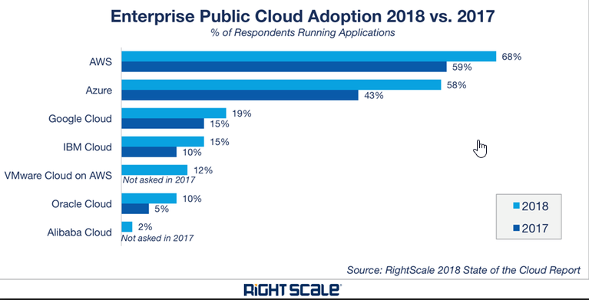
Who is leading in the Cloud Computing world?
AWS is the current leader, since it had a head start.
Azure is close behind with a higher growth rate than AWS. Preferred for fortune 500 companies due to its integration with Microsoft services.
GCP or Google Cloud has the highest growth rate of all since its still getting into the enterprise market.

Slide 13
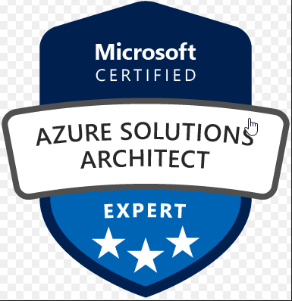
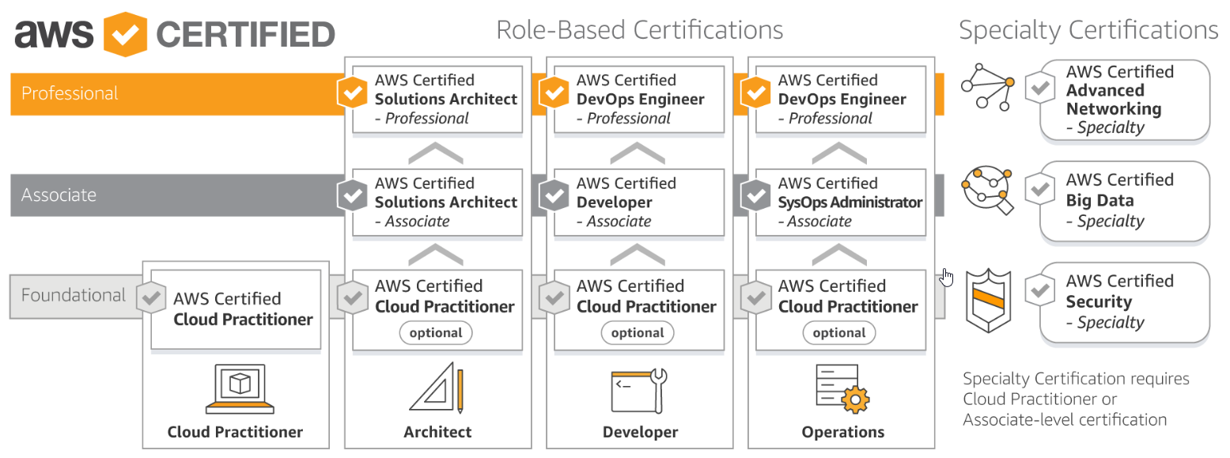
How to become a CC Engineer?
Play around
All Cloud providers provide some type of free trial or free credits.
Certifications.
71% of employers in 2018 stated that they are having a hard time finding the right talent for CC.

Slide 14
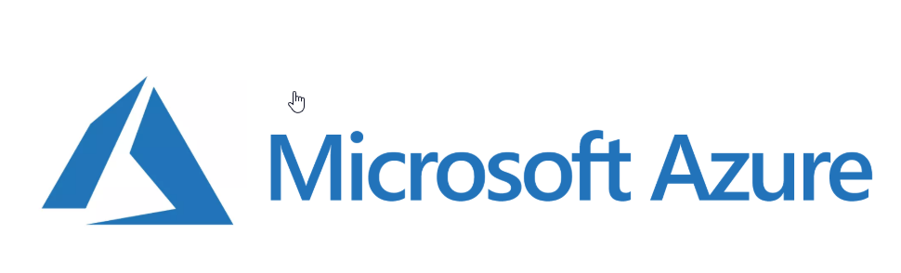
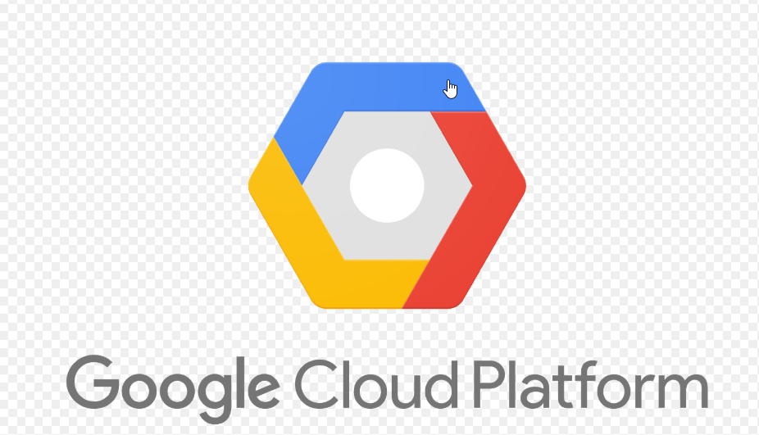
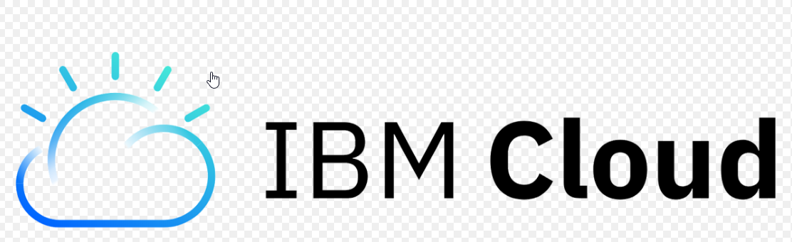
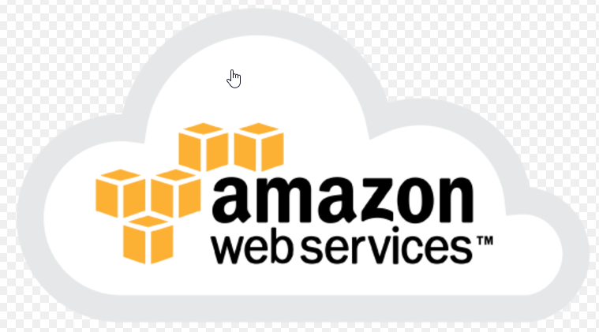
Questions?
Follow me on Linkedin
Follow my blog hammadaslam.com
Notes:
In Slide Show mode, select the arrows to visit links.

